Slide 1
Netzwerk Academy
Name : Prajwal t h
Topic : basics of tableau

Slide 2
TABLEAU
Tableau is the rapidly growing visualization tool used for different business application. It is high in demand software due to its easy access to use. It is widely used in Business Intelligence.
Tableau is an easy, Powerful and fast BI tool which coverts raw data into meaningful information and helps in taking important business decision. The best part about tableau is that there is no prior coding knowledge required in order to learn this.
Analysis with the help of tableau because the visualisations created are in the form of worksheets and dashboards
In the visual analytics, TABLEAU is the market leader

Slide 3
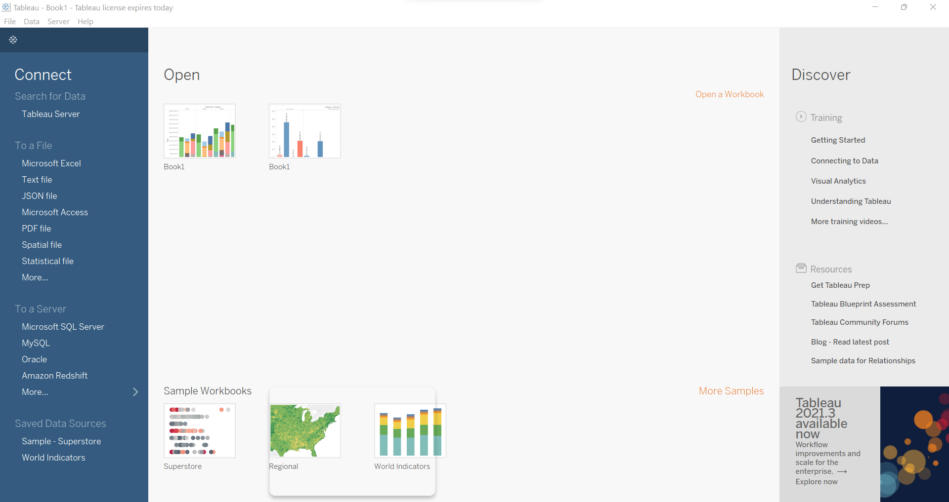

Slide 4
DATA VISUALIZATION
Data visualization is the process of translating large data sets and metrics into charts, graphs and other visuals. The resulting visual representation of data makes it easier to identify and share real-time trends, outliers, and new insights about the information represented in the data.
In simple words, data visualisation converts the raw data into a pictorial representation of the same which makes the data look more attractive, more presentable and helps in making the good decisions about the data.
Example of data visualization tool are Power BI , Qlik Sense.

Slide 5
PROCESS FLOW OF BI PROJECT
BUSINESS UNDERSTANDING
One can work on a particular dataset given by the company or something. But, there are various insights which are hidden under the domain to which data belongs. So, in order to have a good analysis, one should always understand that what the domain/business is about and how the things work there etc.
DATA PREPARATION
After gathering an ample amount of knowledge of the domain , we need to start working on the data now. There are many tasks which come under this part like Removing duplicates , collecting data etc.

Slide 6
PROCESS FLOW OF BI PROJECT
MODELLING
As we know that our data is ready ,now we need to apply all the operations , formulas and functions etc. which are required to achieve the result stated by the organisation.
EVALUATION
This is the last part of the process here. In this part , all the evaluations and report building of the data takes place

Slide 7
THANK YOU…

